Slide 1
PROJECT ON
Feature Extraction and Price Prediction for Mobile Phones
NAME: PANKAJ DEVIKAR
INSTITUTION: DIGICHROME ACADEMY

Slide 2
PROJECT OVERVIEW
This project deals with a dataset that contains detailed information about various mobile phones, having various parameters such as model, color, memory, RAM, battery capacity, rear camera specifications, front camera specifications, presence of AI lens, mobile height and processor, basis on which mobile price is predicted.
My goal is to develop a predictive model for mobile phone prices.

Slide 3
PROBLEM STATEMENT
ProblemStatementwastodesignamodule:
•
WhichisUserFriendly.
•
Whichwillrestricttheuserfromaccessingotherusersdata.
•
Whichwillhelptheadministratortohandleallthechanges.
•
TheSystemwillbecompletelymenudrivensothattheuserswillhavenoproblemsinusingalltheoptions.
•
Thesystemwillbeefficientandfastinresponse.
•
Thesystemwillbecustomizedaccordingtotheneeds.
AD
The organization is keen to enhance its pricing strategy by gaining a deeper understanding of the key features that influence the prices of mobile phones in today's highly competitive market
Develop a predictive model for mobile phone prices based on detailed specifications including model, color, memory, RAM, battery capacity, rear camera specifications,front camera specifications, presence of AI lens, mobile height,
and processor.

Slide 4
DATA SPECIFICATION
Unnamed: 0: An index number representing IDs.
Model: The mobile phone model specification.
Colour: The color of the mobile phone.
Memory: Memory of phone storage.
RAM: RAM memory for the phone.
Battery_: Battery capacity of the phone
Rear Camera: Rear camera lens power.
Front Camera: Front camera lens power.
AI Lens: Presence of AI lens.
Mobile Height: Height of the mobile phone.
Processor_: Processor of the phone.
Price: Price of the mobile phone.

Slide 5
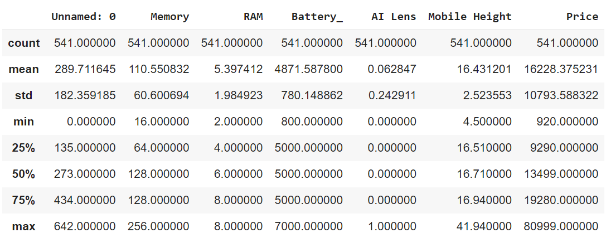
DATA DESCRIPTION

Slide 6
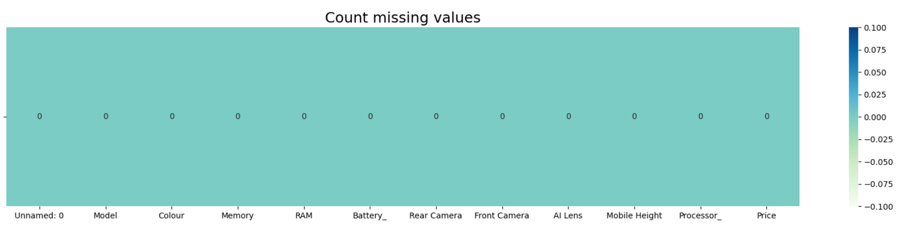
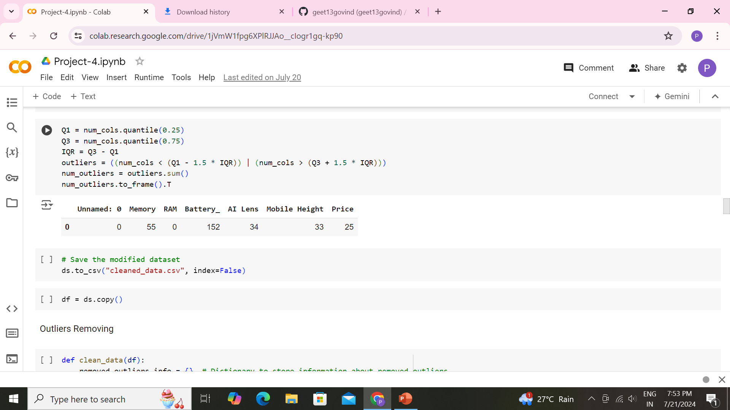
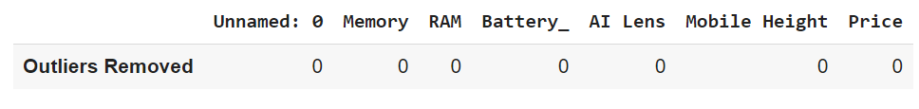
DATA CLEANING

Slide 7
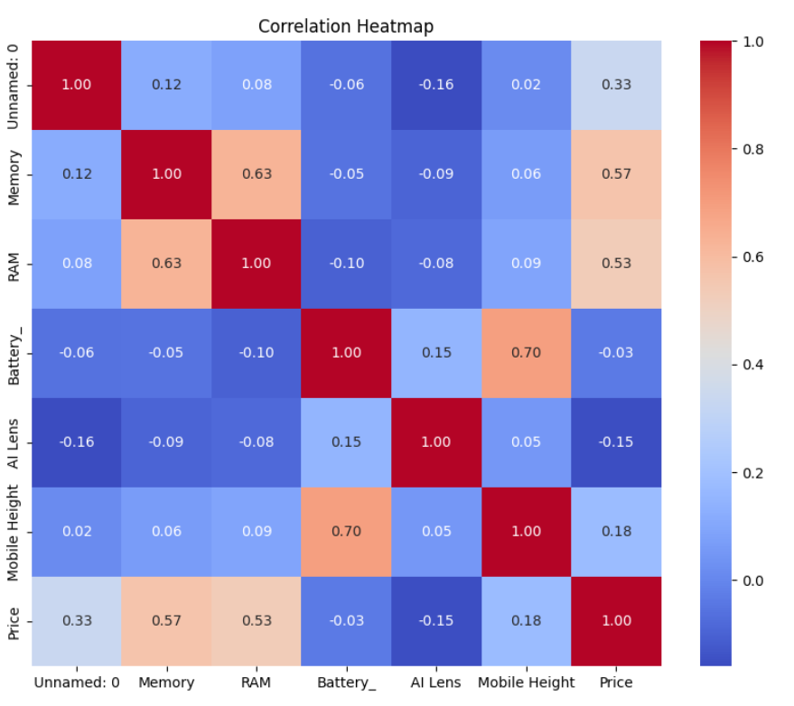
CORRELATION MATRIX
The strong positive relationships between Memory and RAM (0.63), and Battery and Mobile Height (0.7). This indicates that while some features like memory and RAM, and battery capacity and mobile height tend to increase together, most other features do not show strong linear relationships.

Slide 8
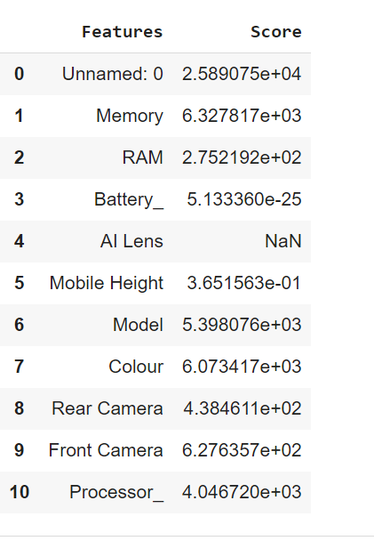
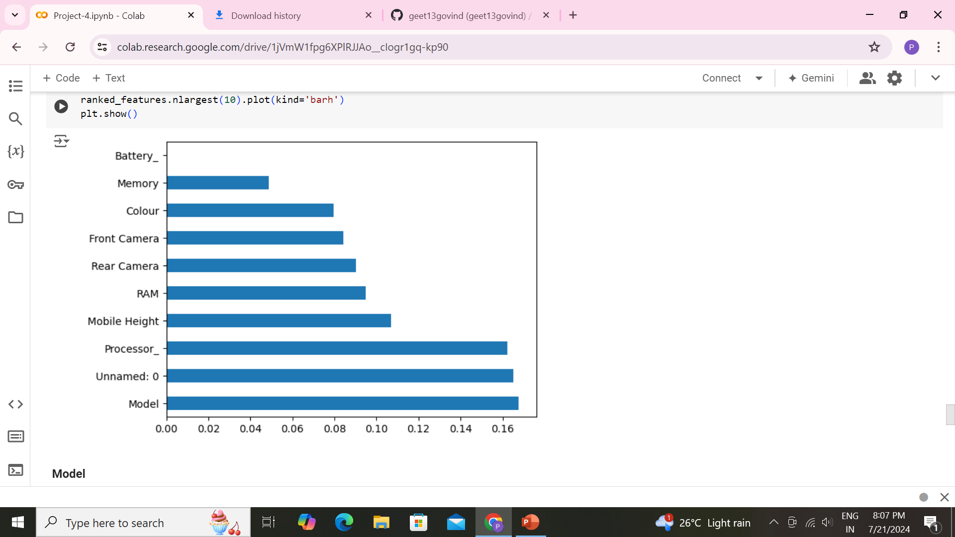
FEATURE EXTRACTION AND IMPORTANCE

Slide 9
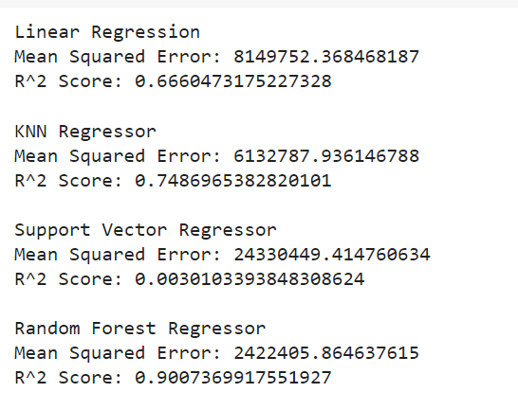
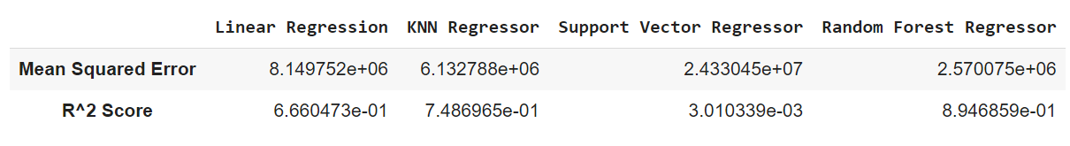
RESULTS

Slide 10
CONCLUSIONS
The Random Forest Regressor is the best performing model among the ones evaluated, with the lowest mean squared error and the highest R² score. The Support Vector Regressor performed the worst, with very high prediction error and almost no explanatory power. The KNN Regressor and Linear Regression models have moderate performance, but the Random Forest Regressor clearly outperforms them.

